Slide 1



15
STARTER:
POPULATION
VOCABULARY
Scrabble!
1.Using topic keywords so far, find the highest ranking word/term!
Use the scrabble points board to help you work out how much each letter is worth.
E.g. birth rate
b3i1r1t1h4 r1a1t1e1=14
2. List as many topic words you can as a list and add them all together for a master total
PRIZES AVAILABLE !

Slide 2

Common Assessment 1 - Revision
September 9th
Learning objective: To assess your learning within the Population Topic so far
Questions on:
Lessons - 8 Billion & Counting
Lessons - Population Demographics
Lessons - The Demographic Transition Model
Lessons - Comparing Population

Slide 3
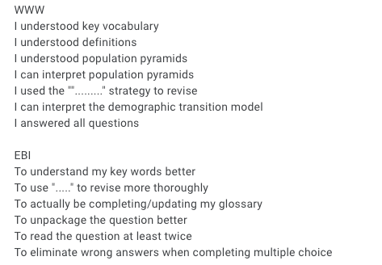
Common Assessment 1
Learning objective: To assess your learning within the Population Topic.
Questions on:
Lesson 1 - 8 Billion & Counting
Lesson 2 - Population Demographics
Lesson 3 - The Demographic Transition Model
50 questions
30 seconds for each

Slide 4
8 Billion and counting!
In 1982, China was the first country to reach a population of 1 billion
India has the biggest population with 1.45 billion people
By 2050 India will nearly have 1.7 Billion people living there
South Sudan has the fastest-growing population with a growth rate of 4.65%

Slide 5
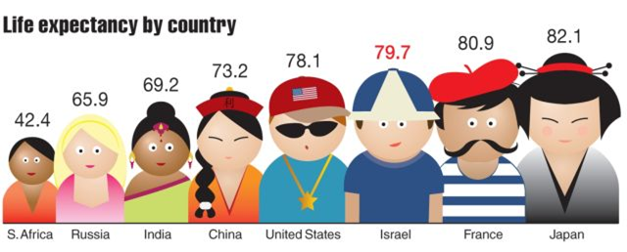
Life expectancy
The average number of years a person is expected to live
Higher or lower in a MEDC?
Why?

Slide 6
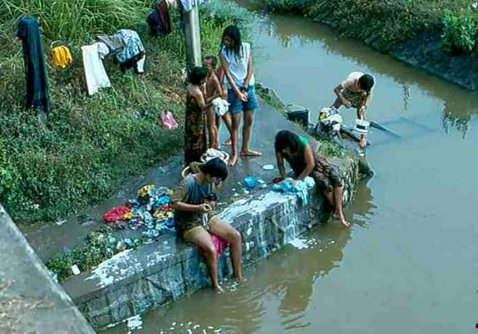
What are the problems caused by large populations?
Jakarta, Indonesia

Slide 7
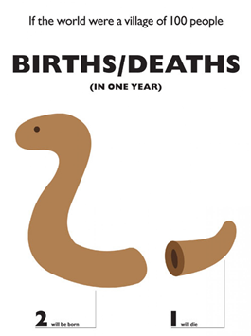
The Demographic Transition Model (DTM)
Why might the numbers of people living in a country change over time?

Slide 8
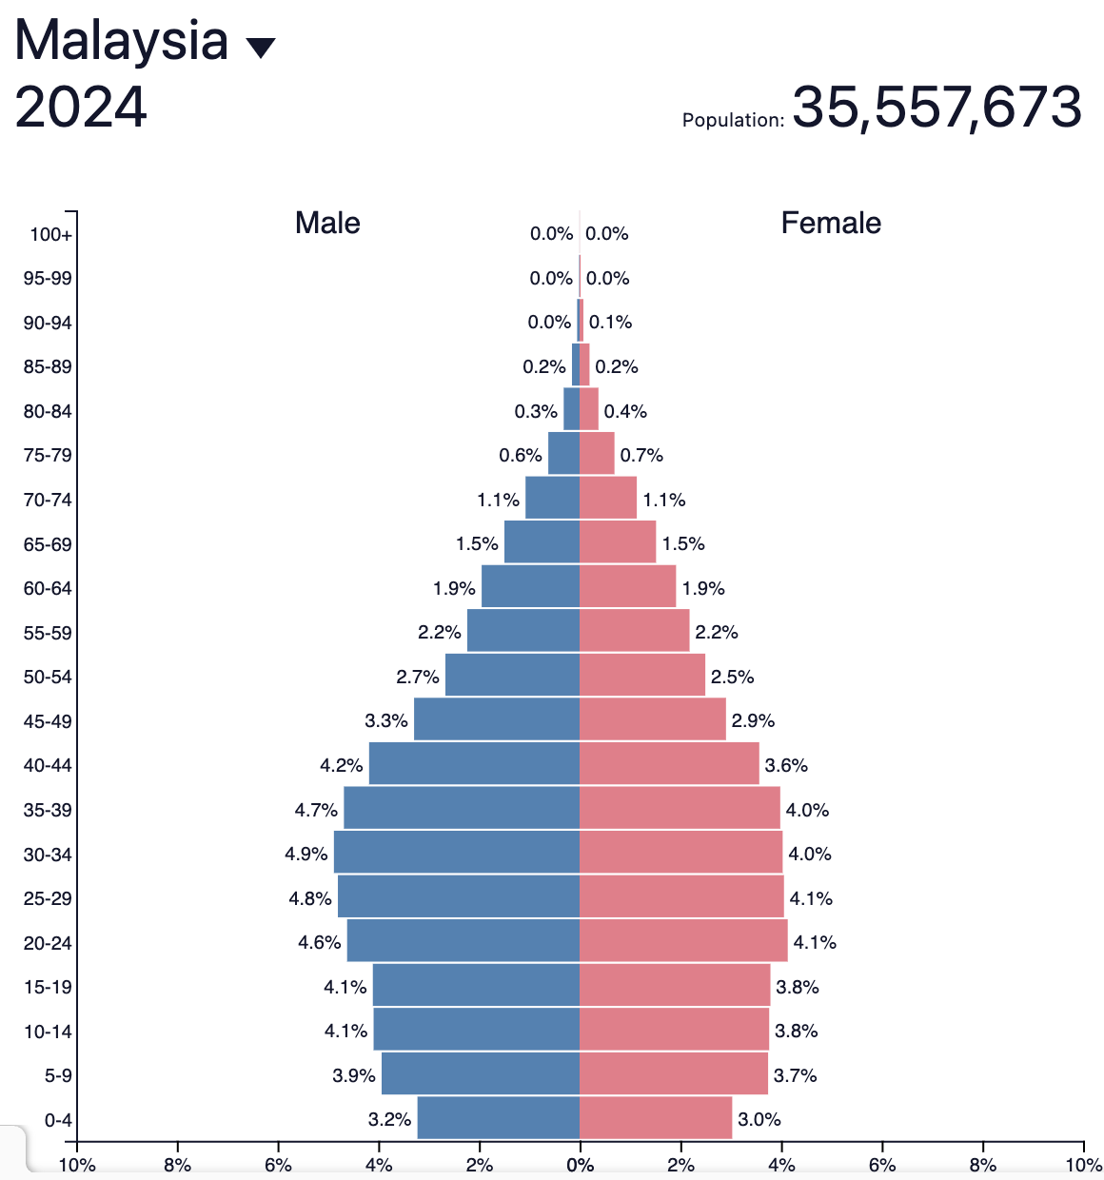
Population Pyramids
How would you describe Malaysia’s population?
Word Bank
Health care, education, young dependents, elderly dependents, working population, death rate birth rate, infant mortality rate, high, low, disease, war, primary industry (farming), life expectancy

Slide 9
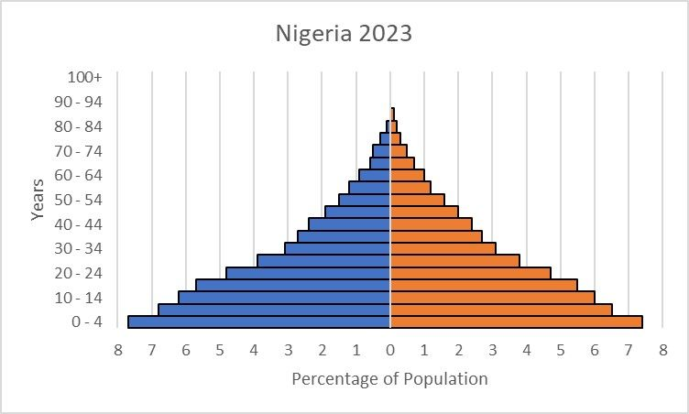
Population Pyramids
How would you describe Nigeria’s population?
Word Bank
Health care, education, young dependents, elderly dependents, working population, death rate birth rate, infant mortality rate, high, low, disease, war, primary industry (farming), life expectancy

Slide 10
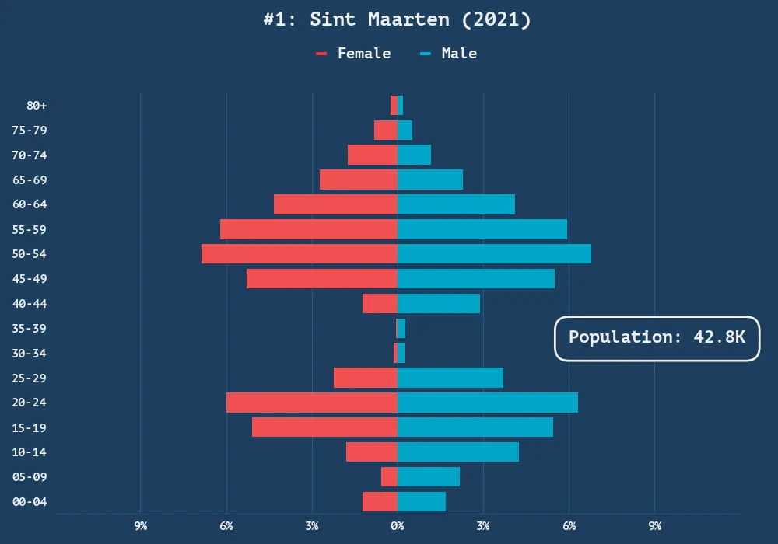
Unusual Population Pyramids
How would you describe it?
Word Bank
Health care, education, young dependents, elderly dependents, working population, death rate birth rate, infant mortality rate, high, low, disease, war, primary industry (farming), life expectancy

Slide 11
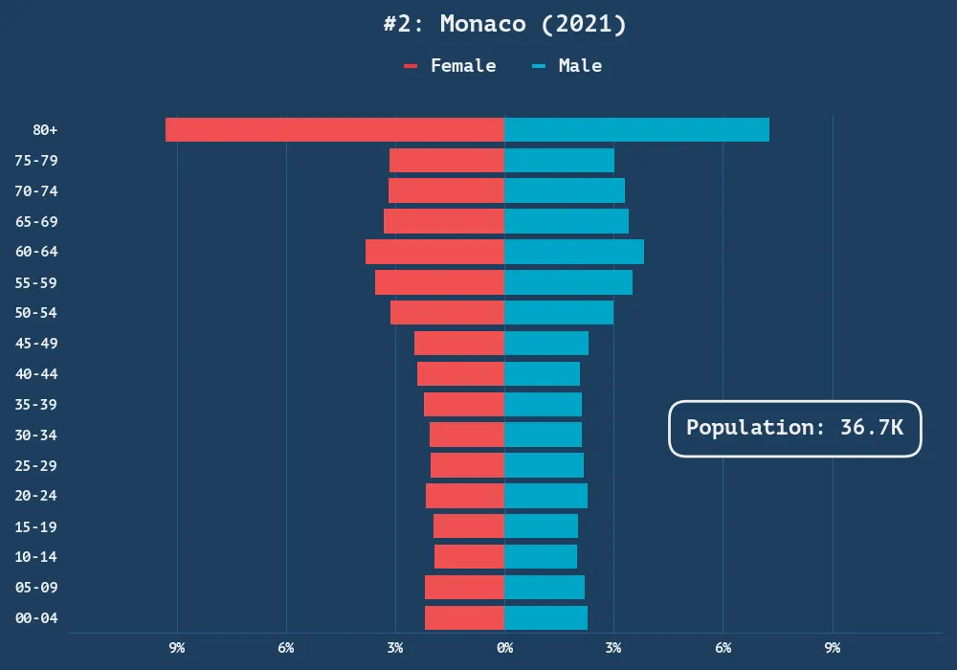
Unusual Population Pyramids
How would you describe it?
Word Bank
Health care, education, young dependents, elderly dependents, working population, death rate birth rate, infant mortality rate, high, low, disease, war, primary industry (farming), life expectancy

Slide 12
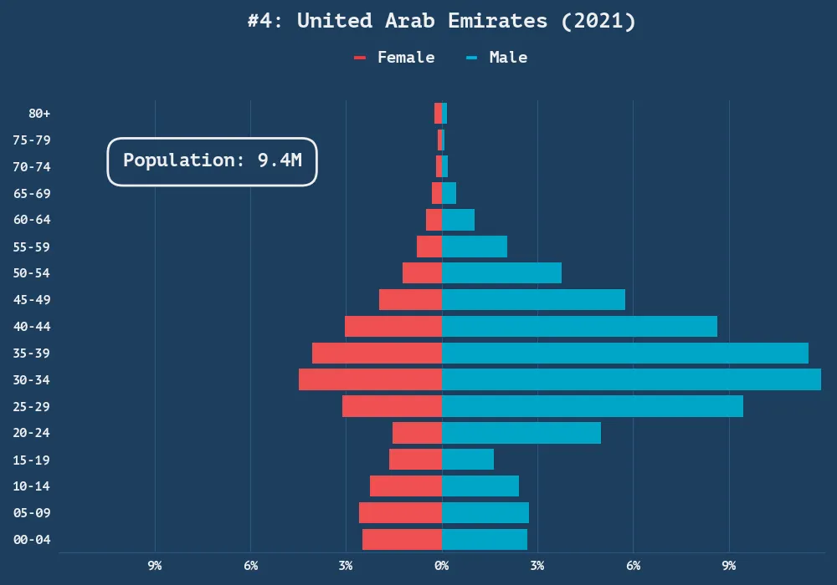
Unusual Population Pyramids
How would you describe it?
Word Bank
Health care, education, young dependents, elderly dependents, working population, death rate birth rate, infant mortality rate, high, low, disease, war, primary industry (farming), life expectancy

Slide 13
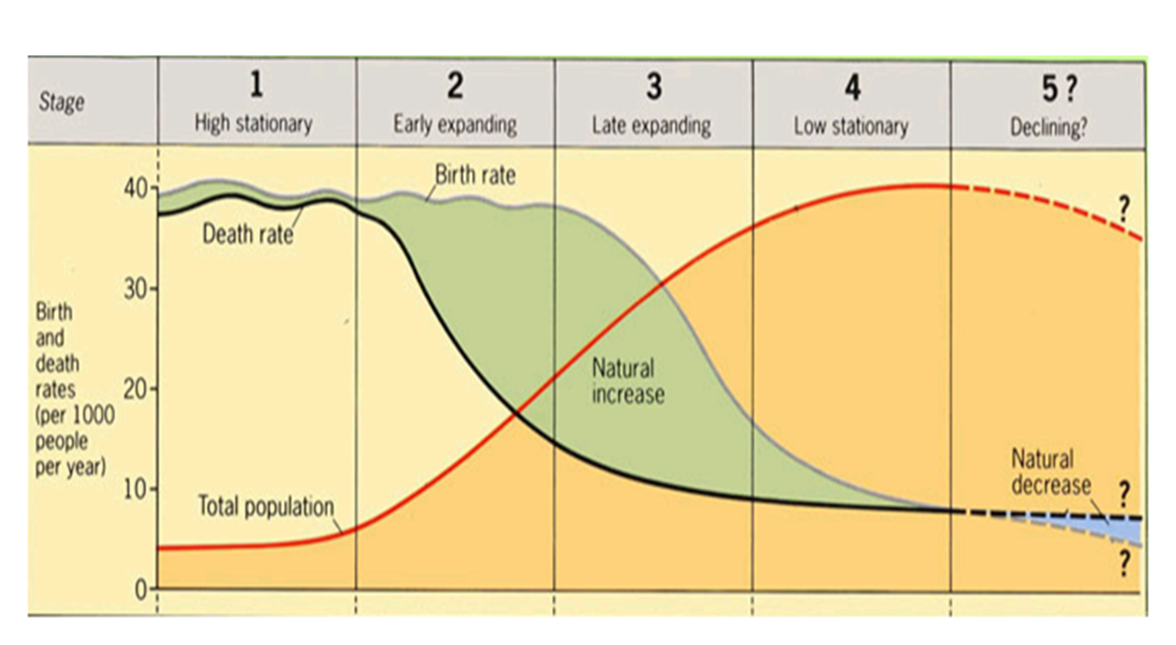
The Demographic Transition Model (DTM)
Stage 5

Slide 14
The Demographic Transition Model (DTM)
Stage 5
Declining population
Why might the population decline?
Birth Rate is lower than the Death Rate

Slide 15
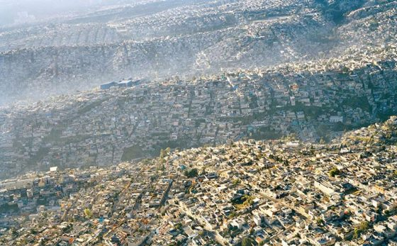
What are the problems caused by large populations?
Mexico City, Mexico

Slide 16
The Demographic Transition Model (DTM)
Stage 4
Large population
Why are births & deaths low?
Low Birth Rate
Low Death Rate

Slide 17
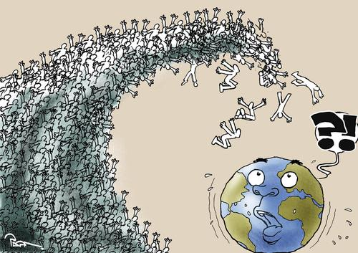
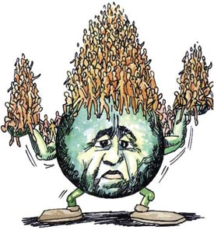
Population Pyramids
Can you identify what message the cartoons are trying to give?

Slide 18
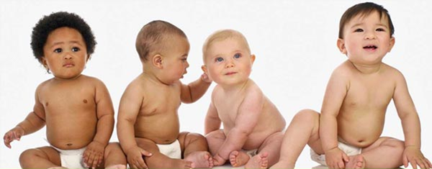
Infant Mortality
The number of babies dying in their first year of life (per 1000 births)
Higher or lower in a MEDC?
Why?

Slide 19
The Demographic Transition Model (DTM)
Stage 1
High Birth Rate
High Death Rate
Why might there be high birth & death rates?
Small population

Slide 20

Comparing Countries
What information would you need to tell whether a country is rich or poor?
Is Malaysia a rich or poor country?

Slide 21
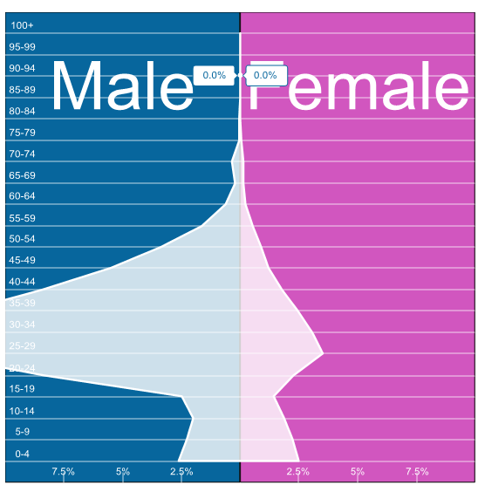
Population Pyramids
Qatar
Why is Qatar’s population pyramid so different to what you would expect?

Slide 22
The Demographic Transition Model (DTM)
Stage 2
High Birth Rate
Declining Death Rate
Why is the population rising?
Rising population

Slide 23
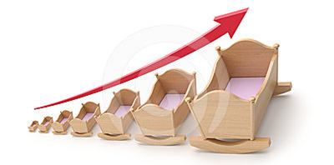
Birth Rate
The number of babies being born per 1000 people
Higher or lower in a HIC?
Why?

Slide 24

Mid Unit Quiz
50 questions
20 seconds for each

